Slide 1
CSE 4128 Lab 3
Histogram Equalization
Dr. Sk. Md. Masudul Ahsan Professor,
Dept. of Computer Science and Engineering,
KUET
Dipannita Biswas
Lecturer,
Dept. of Computer Science and Engineering,
KUET
Kaniz Fatema Isha
Lecturer,
Dept. of Computer Science and Engineering,
KUET

Slide 2
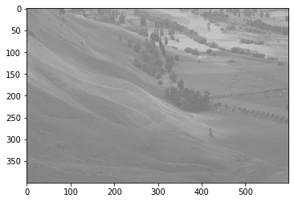
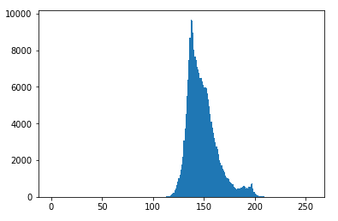
import cv2
import matplotlib.pyplot as plt
#img= image read … …
plt.hist(img.ravel(),256,[0,256])
plt.show()
Input Image
Histogram of the Input Image

Slide 3
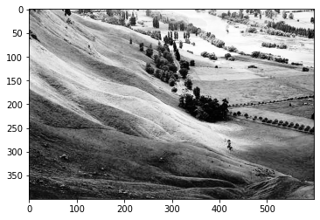
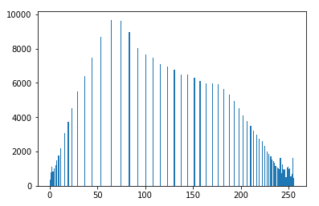
Input Image
Histogram of the Input Image
Equalized Image
Histogram of the Equalized Image

Slide 4
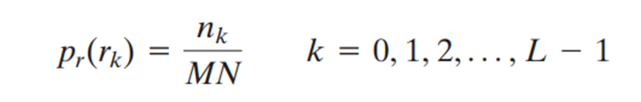
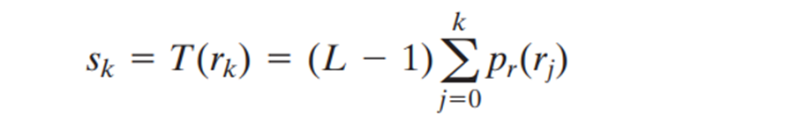
Histogram Equalization
First calculate the PMF (probability mass function) of all the pixels in this image.
Calculate CDF (cumulative distributive function) of the pixels.
Multiply CDF of each pixel value with highest intensity to satisfy the transformation function.
Map each s_{k} to its corresponding r_{k} in the image.

Slide 5
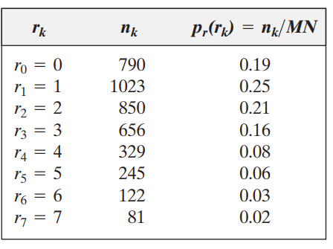
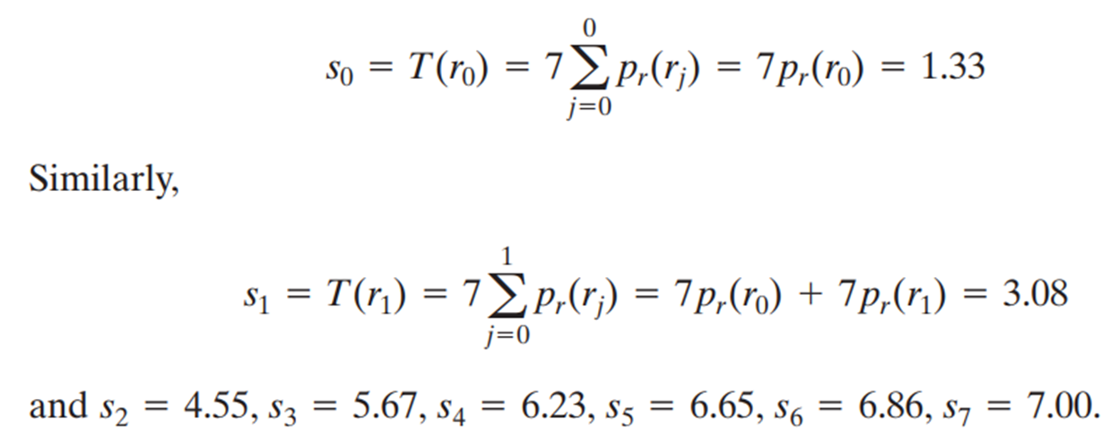
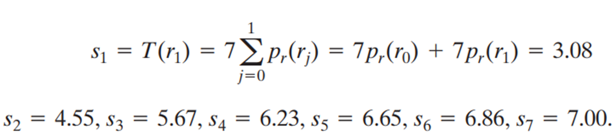

Slide 6
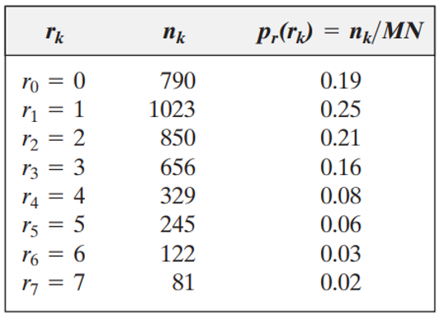
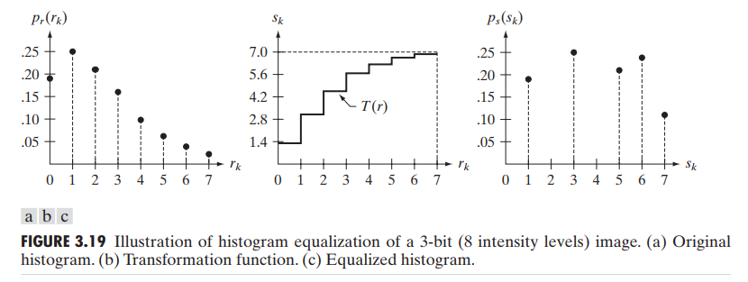
S₀ = 1.33 = 1
S₁ = 3.08 = 3
S₂ = 4.55 = 5
S₃ = 5.67 = 6
S₄ = 6.23 = 6
S₅ = 6.65 = 7
S₆ = 6.86 = 7
S₇ = 7.00 = 7

Slide 7
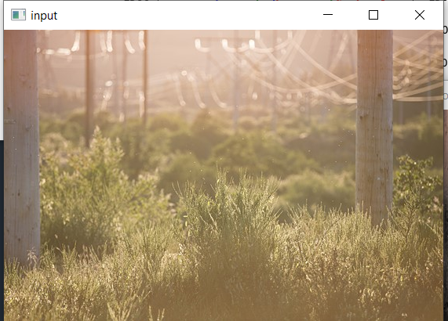
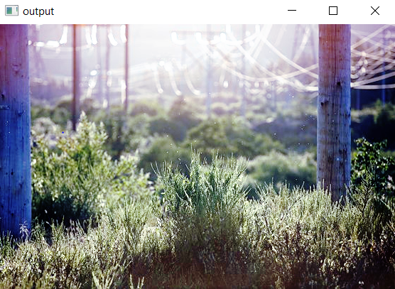
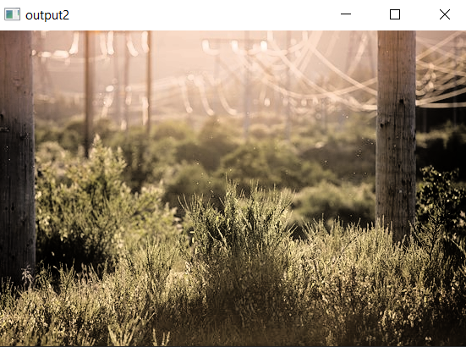
ClassWork

Slide 8
Assignment
Histogram Matching (Specification)
-- where target histogram follows double Gaussian distribution

Slide 9
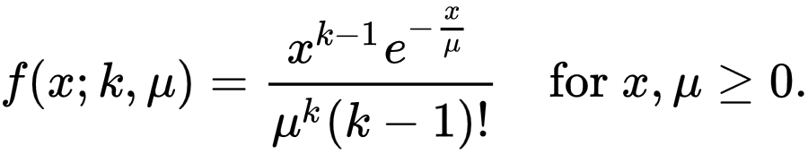
Gaussian distribution
The Erlang distribution is a two-parameter family of continuous probability distributions
Shape parameter (k) (positive integer)
Rate parameter (λ) (positive real number)
The ‘scale parameter’, µ the reciprocal of the rate parameter,μ = 1/λ.

Slide 10
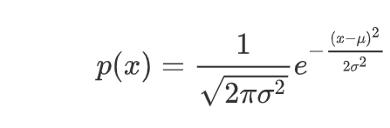
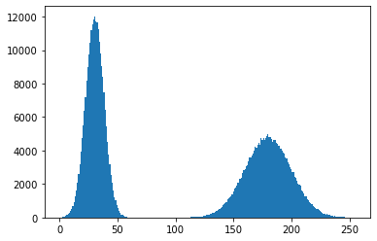
Gaussian distribution
Mean1=30
Sigma1=8
Mean2=165
Sigma2=20

